Slide 1

Clothing Store
By Bellcy Vinitha Samuelraj

Slide 2
Problem statement
Admin Flow:
User flow:
Admins can add a new product with full information about the product.
Admins can edit if the product have any changes and delete the product if the product is removed from the store.
The user can login and check the products that have been listed on the user's home page.
Users can see the product details, add the products to the cart along with the quantity, and remove them if they aren't needed.

Slide 3

Requirements
An angular material is used.
Using pipes, typefilter is done.
Using lazy loading, the login/logout function is done.
Using service calls (Get, Post, Update, Delete) these operations are done.
Using Routing concept, to navigate one page to another page.

Slide 4
Flow Chart
Login
Admin
User
Add
Edit
Delete
Search
View
Add Items to Cart
Delete Item
Delete All Item
Logout

Slide 5
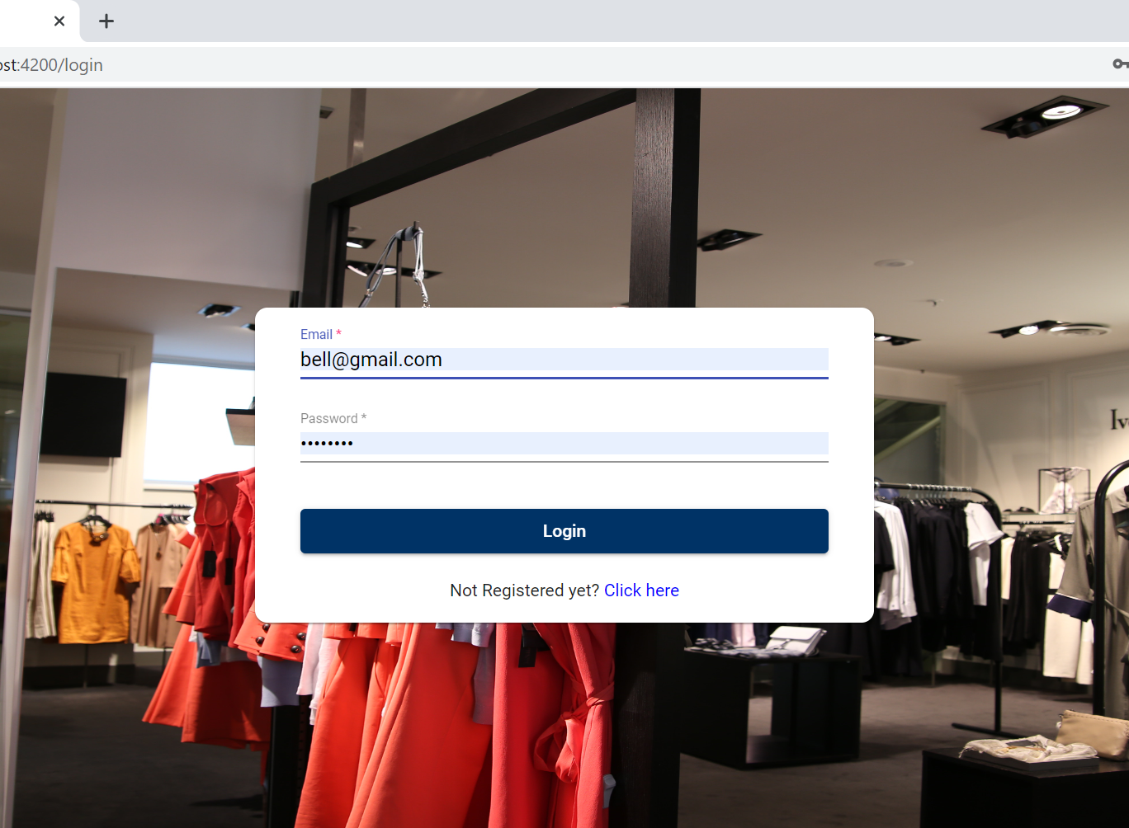
Login Screen
Login screen for the Admin as well as User.

Slide 6
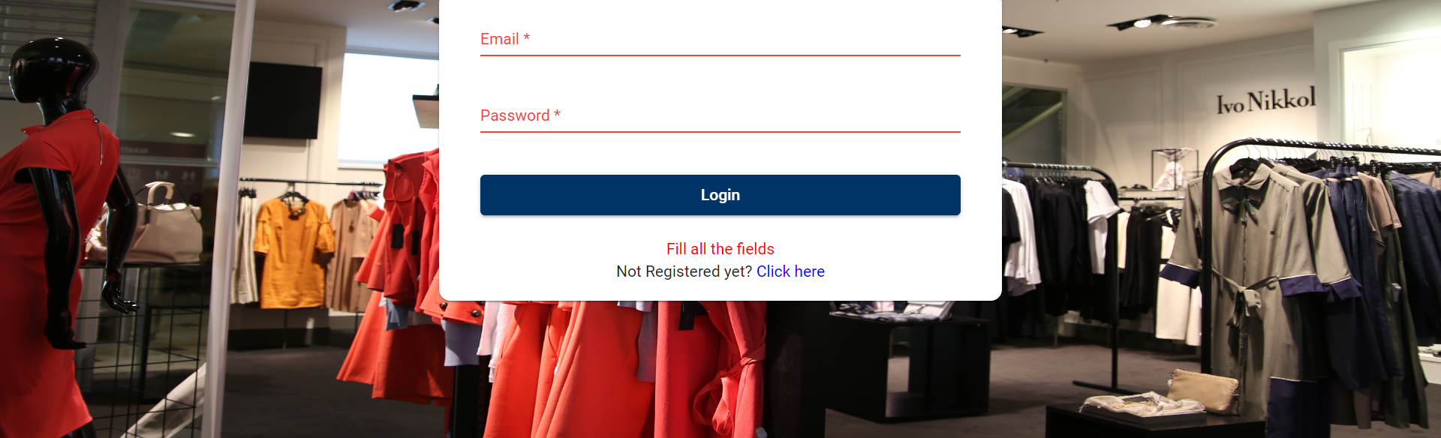
Login Screen
If the Administrator or User doesn’t enter the login credential and tries to login, an error message will be shown asking them to fill out all the details in the form.

Slide 7
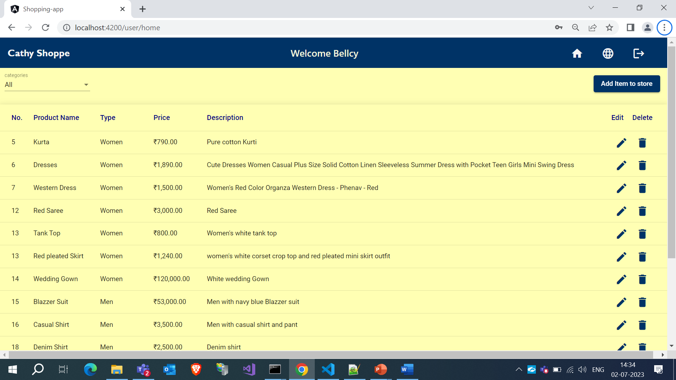
Admin Home Page
Admins can add new products to the application by clicking the Add item to store button.
They can edit the product if there are any updates or changes, and they can even delete the product if they don't need it.
They can filter the product by clicking the category dropdown.

Slide 8
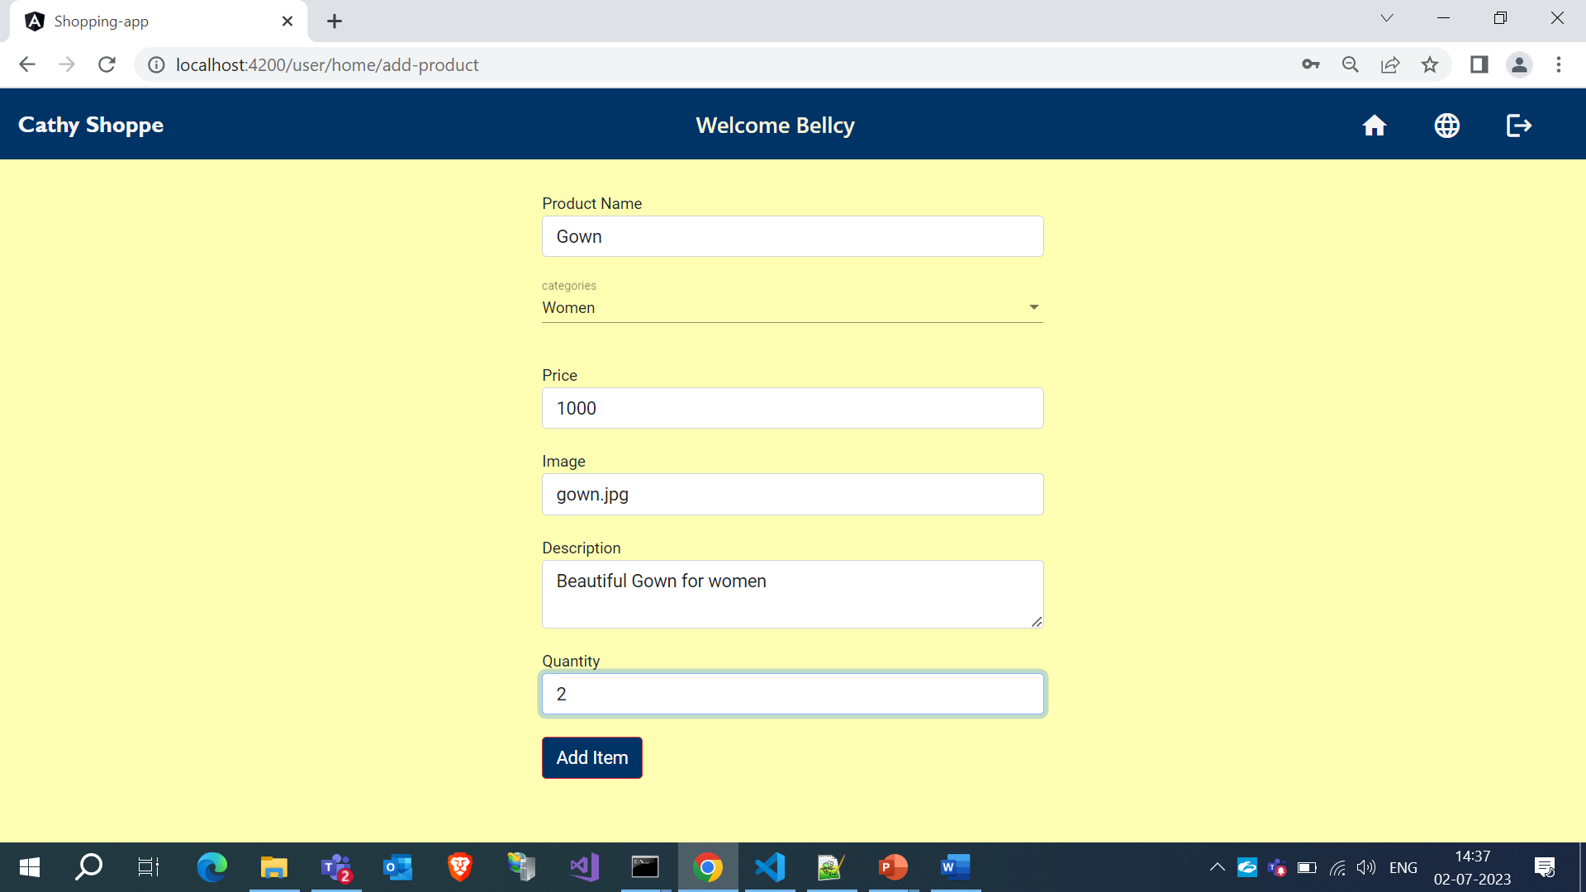
Adding Product Details
By clicking on the Add item to store button, the admin will be redirected to another page where they need to provide the product details.
By clicking on the Add Item button, the product will be added to the list.

Slide 9
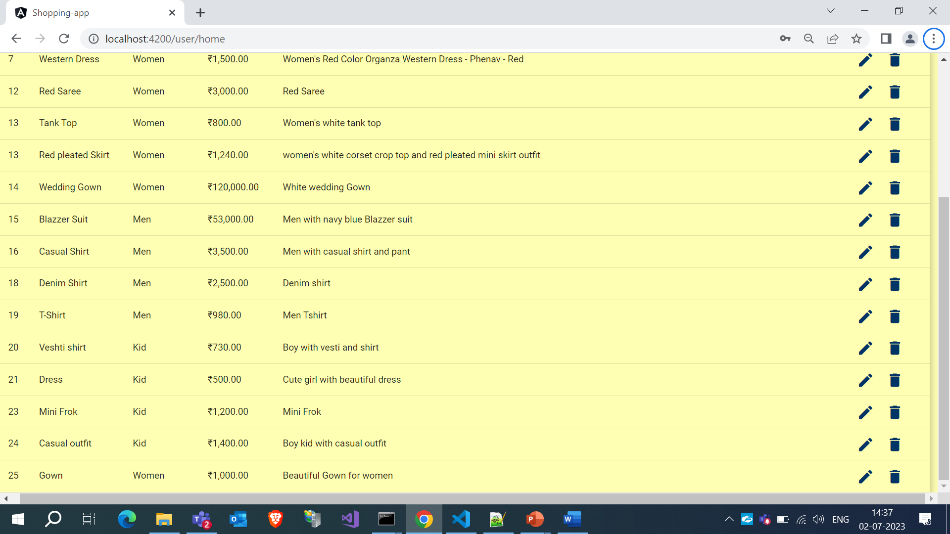
Edit & Delete Products
By Clicking the edit icon, the administrator can edit the particular product that will be updated in the product list.
Through the delete icon, admins can delete the product.

Slide 10
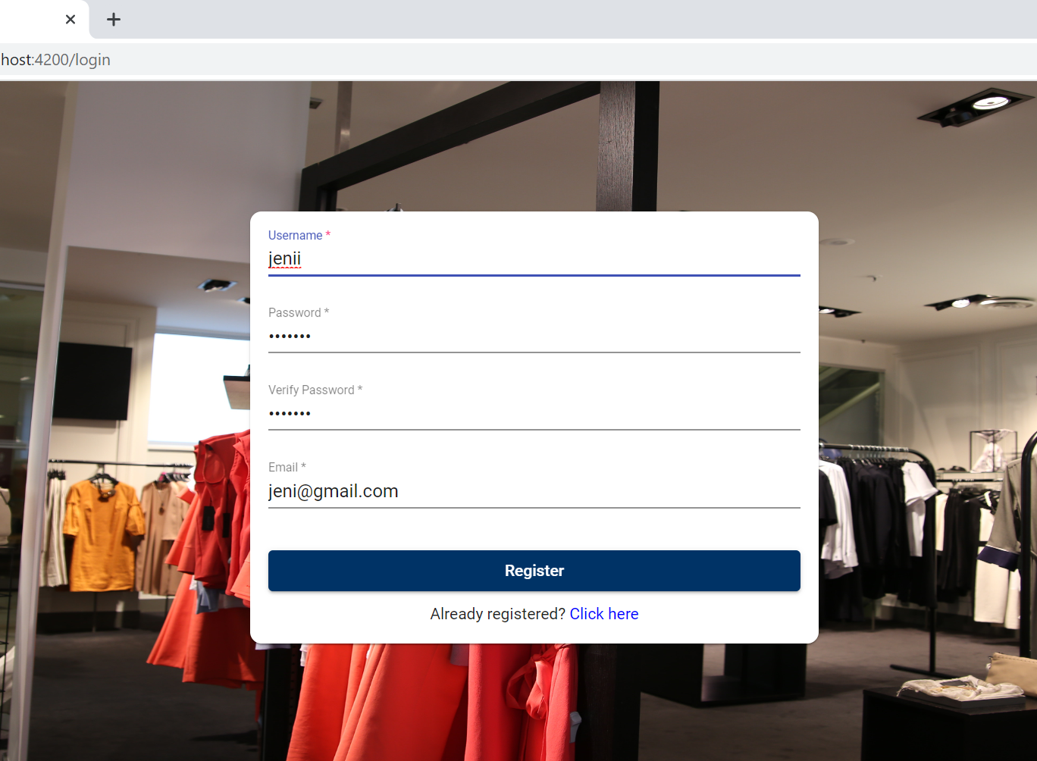
Registration Form
If the user doesn't have any credentials, they need to register in the application by providing their details.
After clicking the register button, they can login to the application.

Slide 11
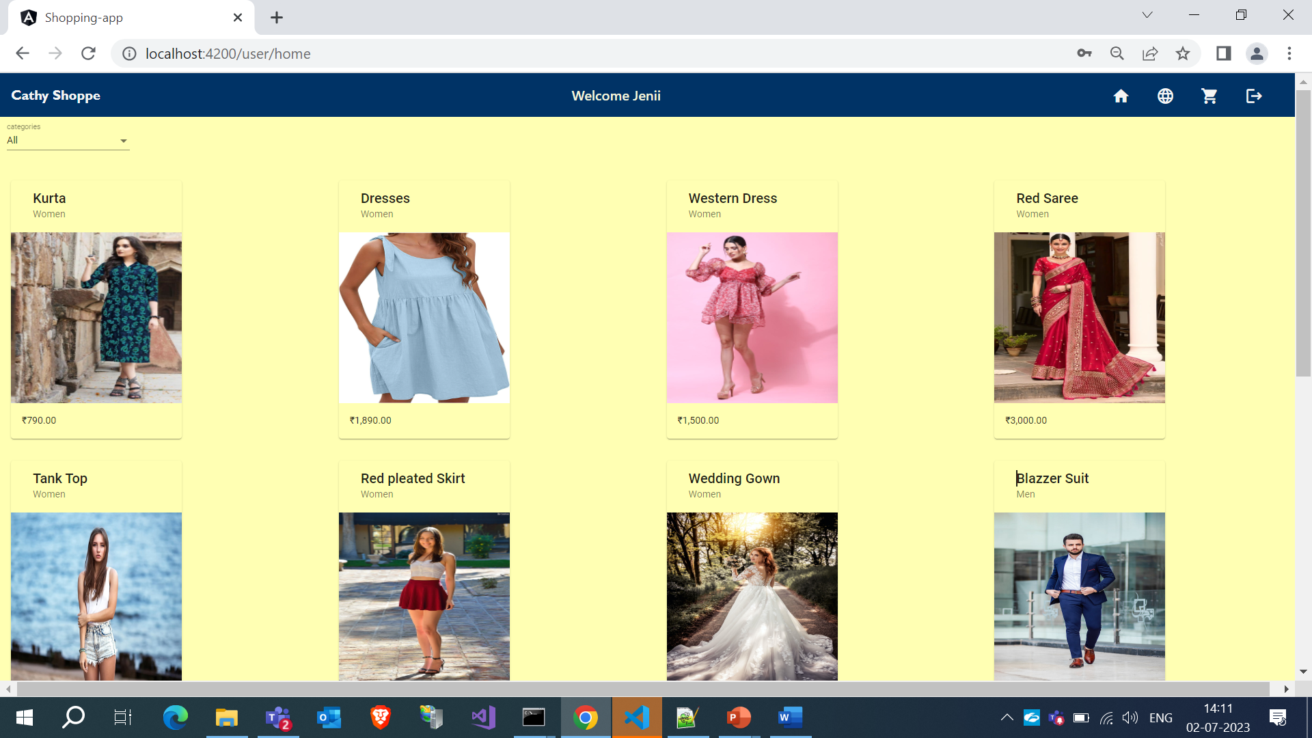
Users Home Page
This is the user's home page.
The products will be displayed with the product name, type, image, and price details.

Slide 12
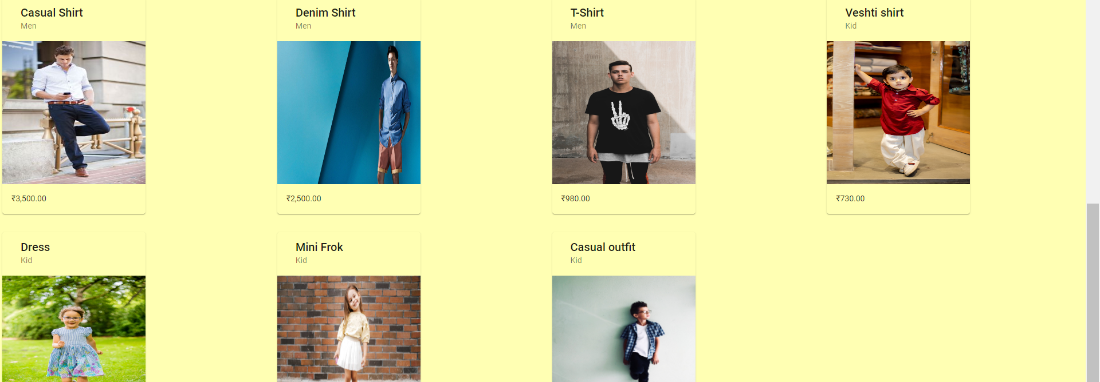
Users Home Page
While clicking on the particular product, it will be redirected to another page that shows all the information and descriptions of the product.

Slide 13
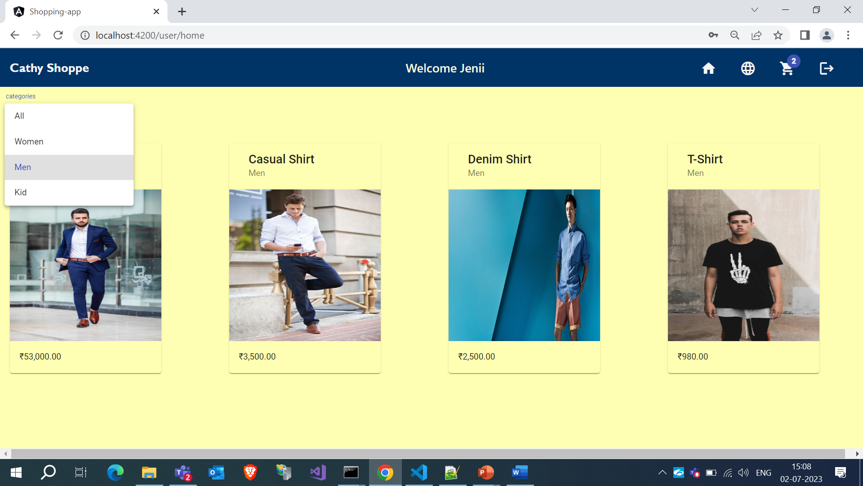
Filtering Method
The user can filter the product by selecting one option in the category dropdown.

Slide 14
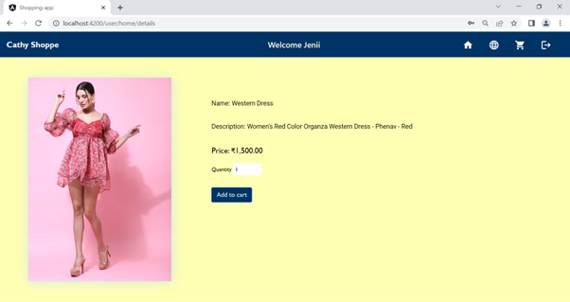
Adding Items to cart
By clicking on the Add to Cart button, the product will be added to the cart.

Slide 15
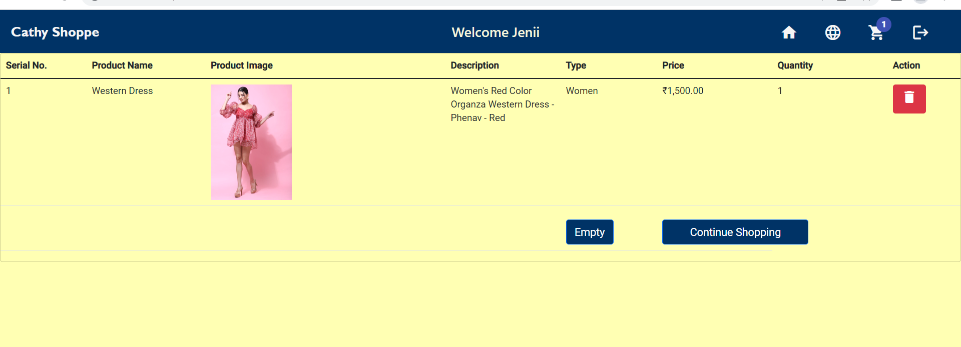
Cart
Through the delete icon, the user is able to delete the product.
By clicking the empty button, all products in the cart will be removed.
The Continue Shopping button will redirect the user to the user's home page.

Slide 16

Language setting
The user can change the language by clicking the global icon in the menu.

Slide 17
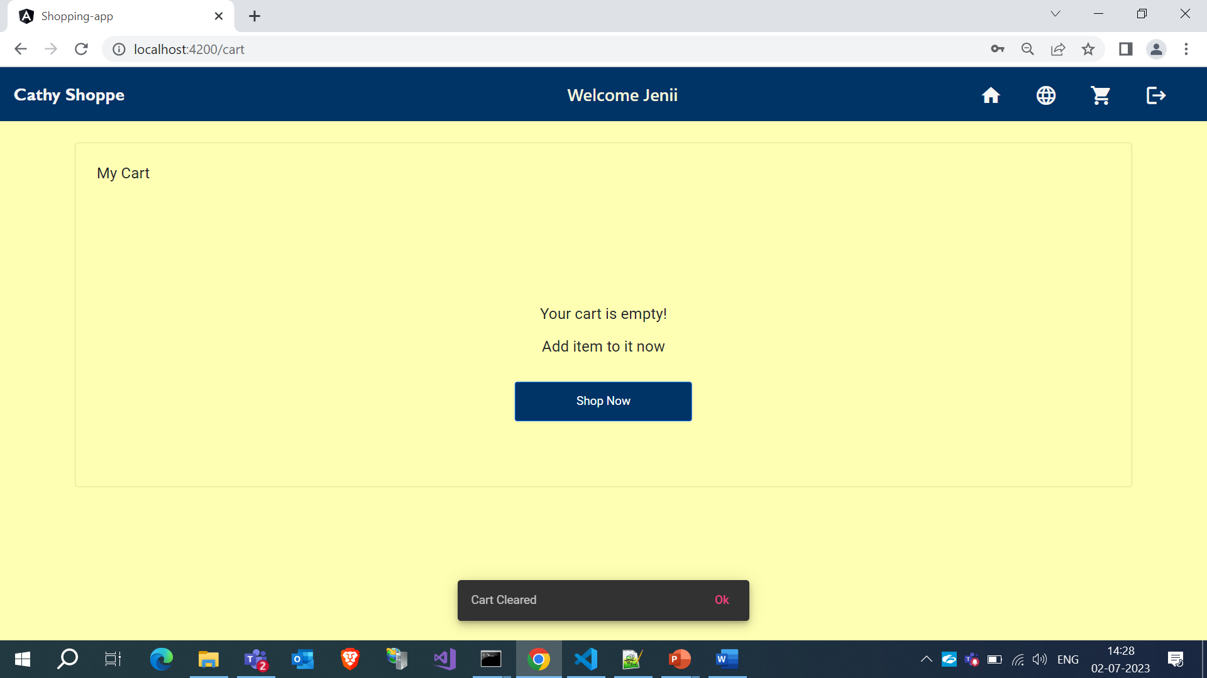
Cart
After clearing the cart, products in the cart will be removed.
The Shop now button will redirect the user to the user's home page.

Slide 18

THANK YOU

